Slide 1

Course code : CSE4001 Course title : Cloud Computing Module : 1 Session : 8
Goals & Benefits pp.40-43
Risks & Challenges pp.45-48

Slide 2
Objectives
This session will give the knowledge about
Goals & Benefits
Risk Factors associated with Cloud Environments
Challenges

Slide 3
Goals & Benefits
The common benefits associated with adopting cloud computing are.
Reduced Investments and Proportional Costs
Increased Scalability
Increased Availability and Reliability

Slide 4
Reduced Investments and Proportional Costs
Common measurable benefits to cloud consumers include:
On-demand access to pay-as-you-go computing resources on a short-term basis (such as processors by the hour), and the ability to release these computing resources when they are no longer needed.(whatever u use, just pay)
The perception of having unlimited computing resources that are available on demand, thereby reducing the need to prepare for provisioning.(If its available, use it)
The ability to add or remove IT resources at a fine-grained level, such as modifying available storage disk space by single gigabyte increments.(If u want to extend/shrink the resource, just do )
Abstraction of the infrastructure are not locked into devices/locations so it can be easily moved if needed.(if u want migrate infra(vm), move it)

Slide 5
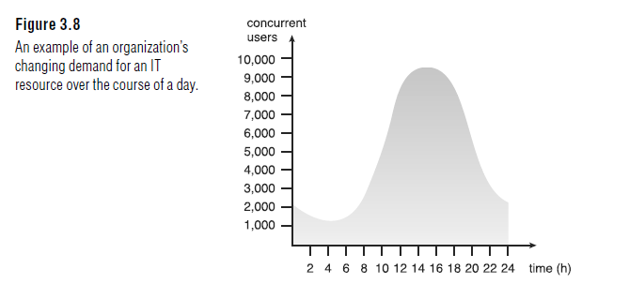
Increased Scalability
Clouds can instantly and dynamically allocate IT resources to cloud consumers as on-demand basis or via the cloud consumer’s direct configuration.
cloud’s ability to scale IT resources on-demand

Slide 6
Increased Availability and Reliability
The availability and reliability of IT resources are directly associated with tangible business benefits.
Outages limit the time an IT resource can be “open for business” for its customers, thereby limiting its usage and revenue generating potential .

Slide 7
Risks and Challenges
Several of the most critical cloud computing challenges pertaining mostly to cloud consumers that use IT resources located in public clouds are presented here..
Increased Security Vulnerabilities
Reduced Operational Governance Control
Limited Portability Between Cloud Providers
Multi-Regional Compliance and Legal Issues

Slide 8
1.Increased Security Vulnerabilities
Moving of business data to the cloud means that, the responsibility over data security becomes shared with the cloud provider. The remote usage of IT resources requires an expansion of trust boundaries by the cloud consumer to include the external cloud.
It can be difficult to establish a security architecture that spans such a trust boundary without introducing vulnerabilities, unless cloud consumers and cloud providers happen to support the same or compatible security frameworks—which is unlikely with public clouds.

Slide 9
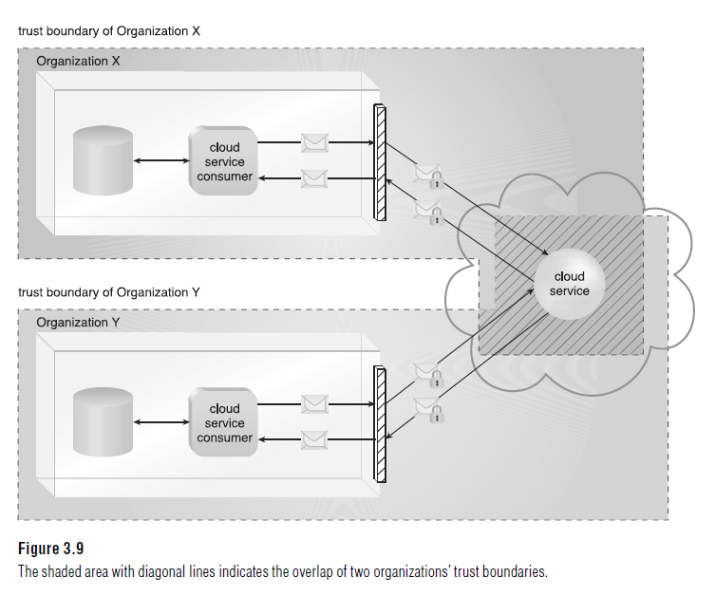

Slide 10
2.Reduced Operational Governance Control
A cloud governance system is established through SLAs, given the “as-a-service” nature of cloud computing.
A cloud consumer must keep track of the actual service level being offered and the other Warranties that are made by the cloud provider.
Note that different cloud delivery models offers varying degrees of operational control granted to cloud consumers.

Slide 11
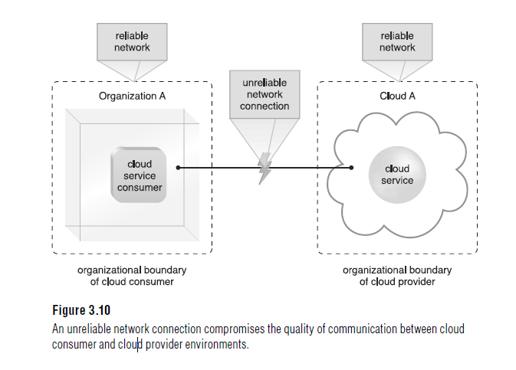

Slide 12
3.Limited Portability Between Cloud Providers
Due to a lack of established industry standards within the cloud computing industry, public clouds are commonly proprietary to various extents. For cloud consumers that have custom-built solutions with dependencies on these proprietary environments, it can be challenging to move from one cloud provider to another.
Portability is a measure used to determine the impact of moving cloud consumer IT resources and data between clouds.

Slide 13
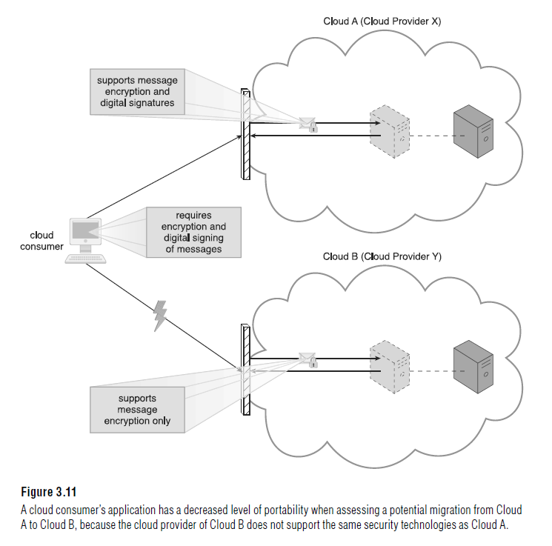
Limited Portability Between Cloud Providers

Slide 14
4. Multi-Regional Compliance and Legal Issues
Third-party cloud providers will frequently establish data centers in affordable or convenient geographical locations. Cloud consumers will often not be aware of the physical location of their IT resources and data when hosted by public clouds.
For some organizations, this can pose serious legal concerns pertaining to industry or government regulations that specify data privacy and storage policies.
Another potential legal issue pertains to the accessibility and disclosure of data.

Slide 15
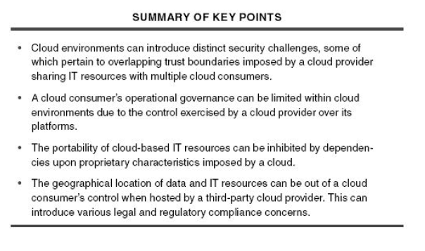
Summary
This session will give the knowledge about

Slide 16
Open Quiz -1

Slide 17
Q1
_________ computing refers to applications and services that run on a distributed network using virtualized resources.

Slide 18
Q2.
Point out the wrong statement.
a) The massive scale of cloud computing systems was enabled by the popularization of the Internet b) Soft computing represents a real paradigm shift in the way in which systems are deployed c) Cloud computing makes the long-held dream of utility computing possible with a pay-as-you-go, infinitely scalable, universally available system d) All of the mentioned

Slide 19
Q3
________ as a utility is a dream that dates from the beginning of the computing industry itself. a) Model b) Computing c) Software d) All of the mentioned

Slide 20
Q4
Which of the following is essential concept related to Cloud? a) Reliability b) Productivity c) Abstraction d) All of the mentioned

Slide 21
Q5
Point out the wrong statement. a) All applications benefit from deployment in the cloud b) With cloud computing, you can start very small and become big very fast c) Cloud computing is revolutionary, even if the technology it is built on is evolutionary d) None of the mentioned

Slide 22
Q6
Which of the following cloud concept is related to pooling and sharing of resources? a) Polymorphism b) Abstraction c) Virtualization d) None of the mentioned

Slide 23
Q7
________ has many of the characteristics of what is now being called cloud computing. a) Internet b) Softwares c) Web Service d) All of the mentioned

Slide 24
Q8
Which of the following can be identified as cloud? a) Web Applications b) Intranet c) Hadoop d) All of the mentioned

Slide 25
Q9
Cloud computing is an abstraction based on the notion of pooling physical resources and presenting them as a ________ resource. a) real b) virtual c) cloud d) none of the mentioned

Slide 26
Q10
Which of the following is Cloud Platform by Amazon? a) Azure b) AWS c) Cloudera d) All of the mentioned

Slide 27
Next
Ubuntu enterprise cloud is used to create-
Google App Engine (often referred to as GAE or simply App Engine) is
Heroku was acquired by
Which of the following is not cloud service provider ?
a. Amazon
b. Amazon EC2
c. Hadoop
d. GAE
e. Azure
What is Caas ?

Slide 28
ANSWERS
b) Cloud
b) Soft computing represents a real paradigm shift in the way in which systems are deployed
b) Computing
c) Abstraction
a) All applications benefit from deployment in the cloud
c) Virtualization
a) Internet
c) Hadoop
b) virtual
b) AWS

Slide 29
Next
Ubuntu enterprise cloud is used to create- private cloud
Google App Engine (often referred to as GAE or simply App Engine) is- PaaS
Heroku was acquired by – Salesforce.com
Which of the following is not cloud service provider ?
a. Amazon
b. Amazon EC2
c. Hadoop
d. GAE
e. Azure
What is Caas ? – Communication as a Service

